Slide 1


AEROKLASDUYS (Pty) Ltd
“X” Rider 2026 Design Proposal
DUNS: 539097752
Private & Confidential ISUZU & ARKD Use Only
Designer : Grace Mata Futi
Date: 09 April 2025

Slide 2
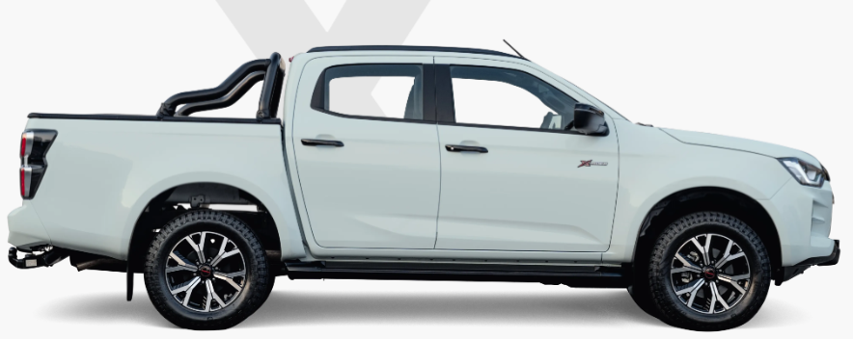
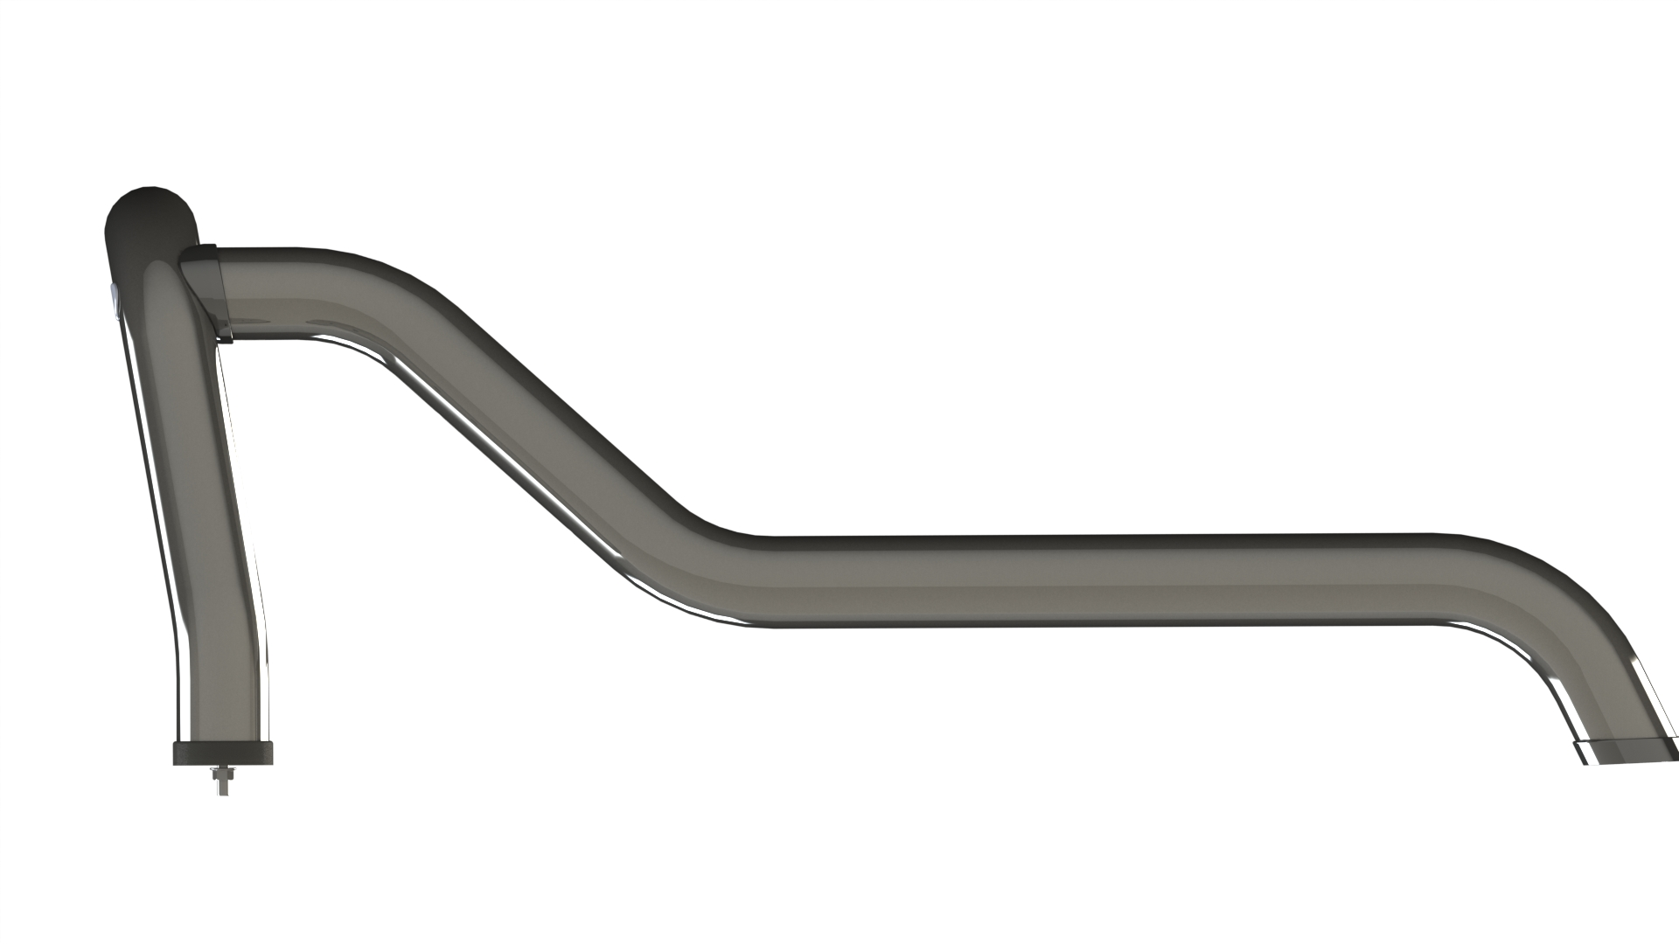
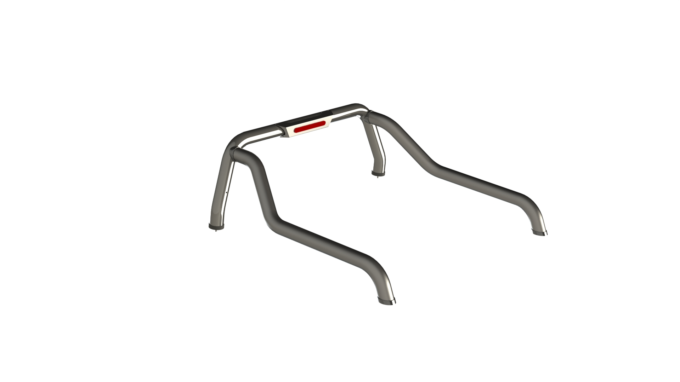
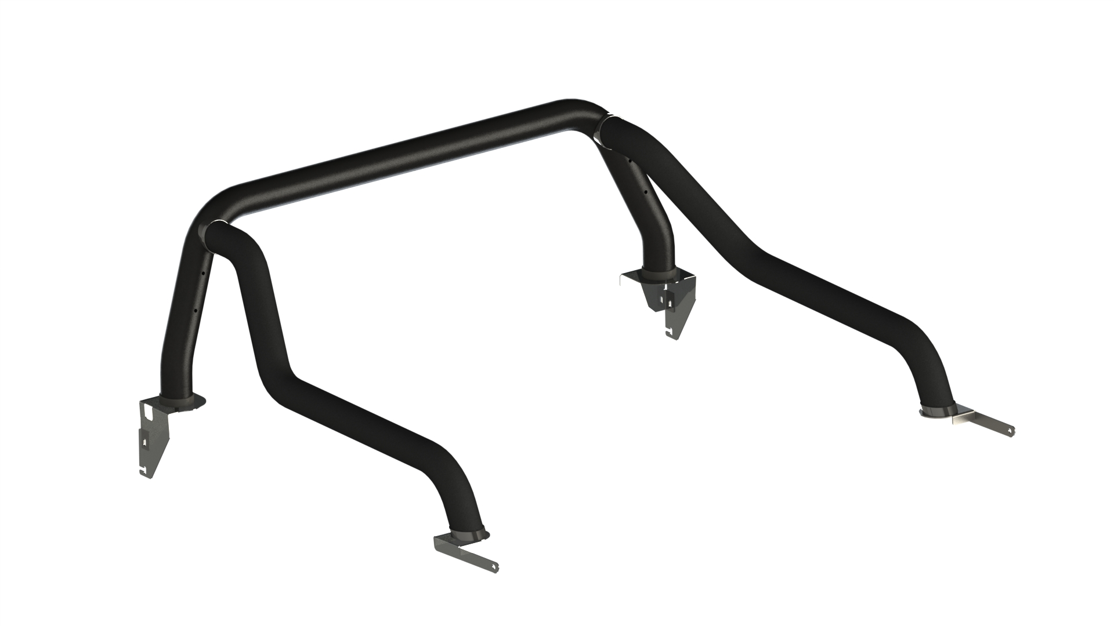
Concept 1: Isuzu Styling Bar without Side Plate: Mild and Stainless
Note:
Front tube profile and front tube end cap rubber are the same as RG06.
Rear tube profile design changed; rear tube end cap rubber is the same as RG06.
Sill mount design changed, from front and rear mounting.
There is option for brake light. Stainless and Mild Steel
Without Brake Light
With Brake Light
Designer : Grace Mata Futi
Date: 09 April 2025

Slide 3
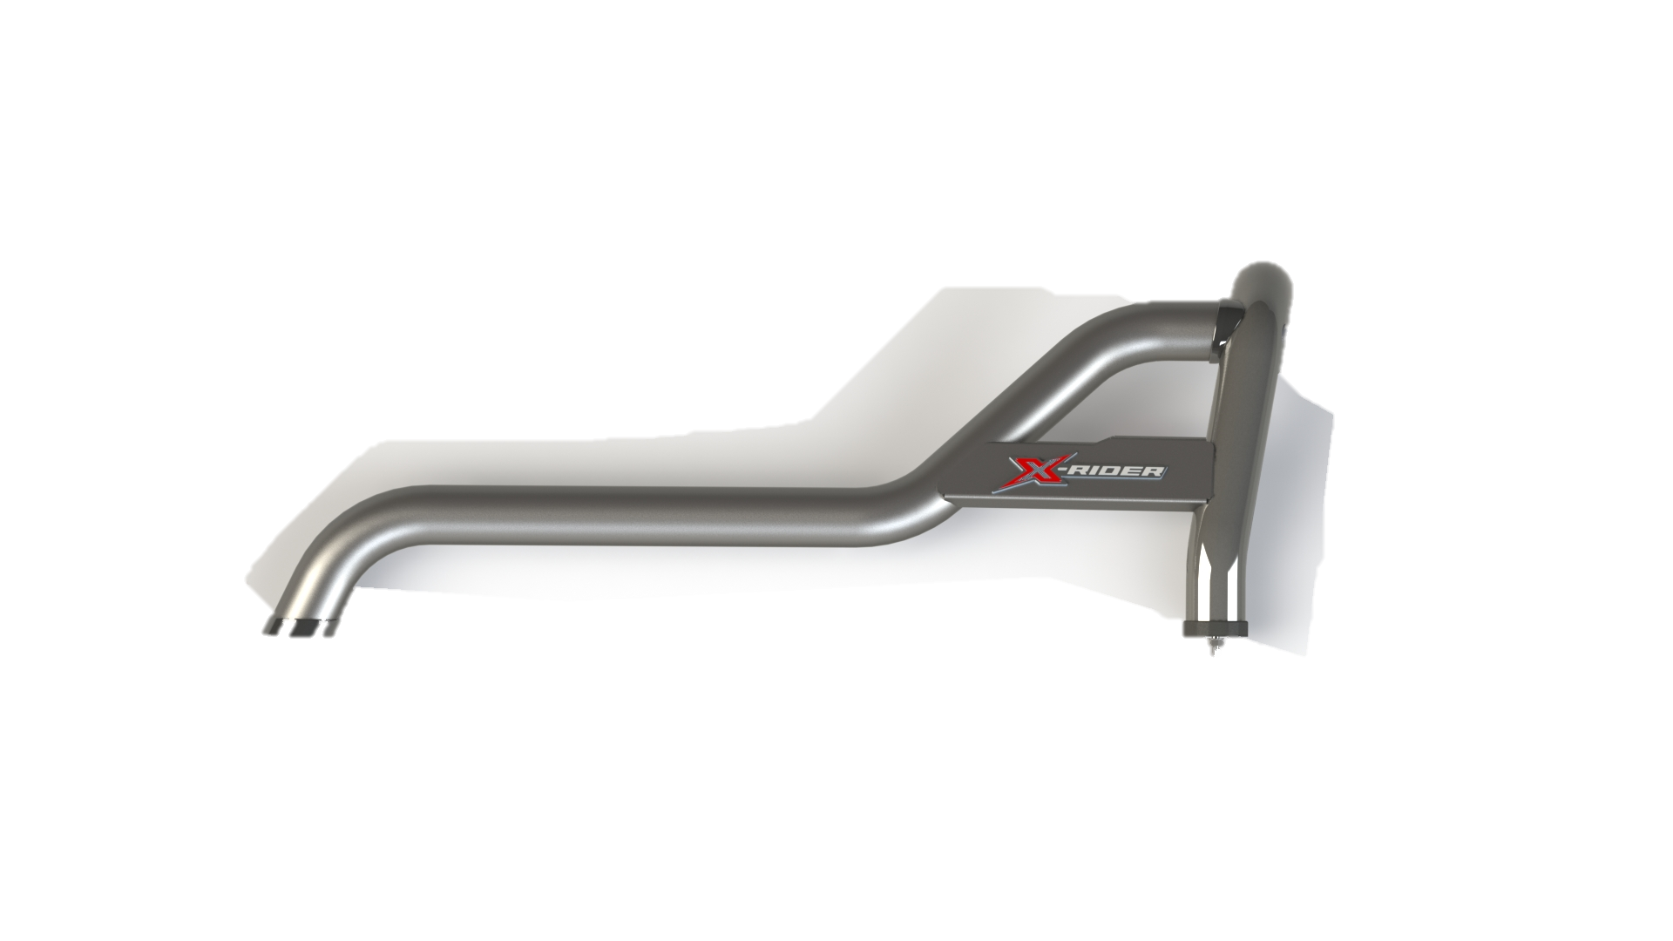
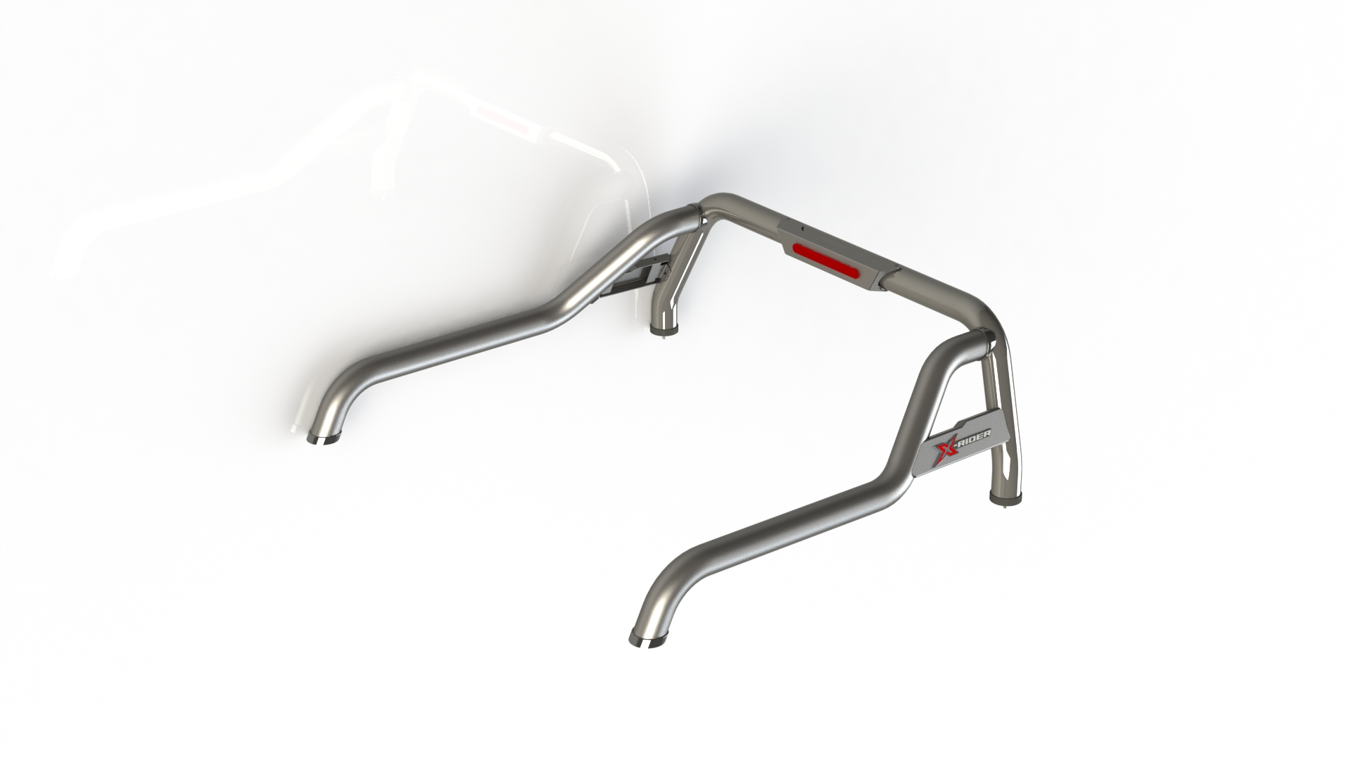
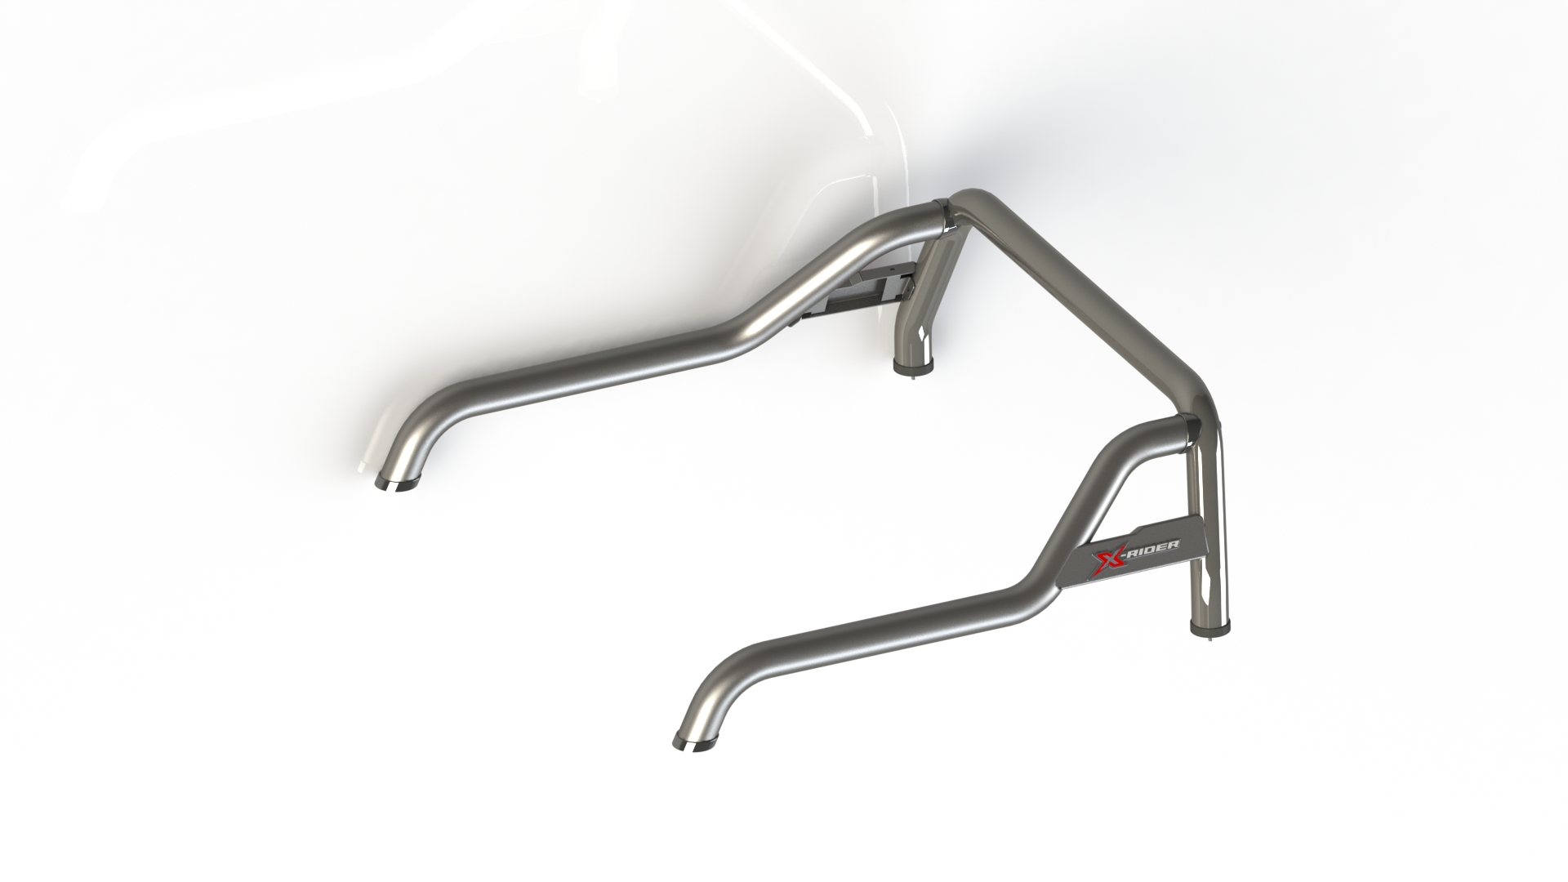
Concept 2: Isuzu Styling Bar with Side Plate (X-Rider and D-Max)
Note:
Front tube profile and front tube end cap rubber are the same as RG06.
Rear tube profile design changed; rear tube end cap rubber is the same as RG06.
Sill mount design changed, from front and rear mounting.
This concept has side plate and X rider sticker.
There is option for brake light. Stainless and Mild Steel.
With Brake light
With no Brake light
Designer : Grace Mata Futi
Date: 09 April 2025

Slide 4
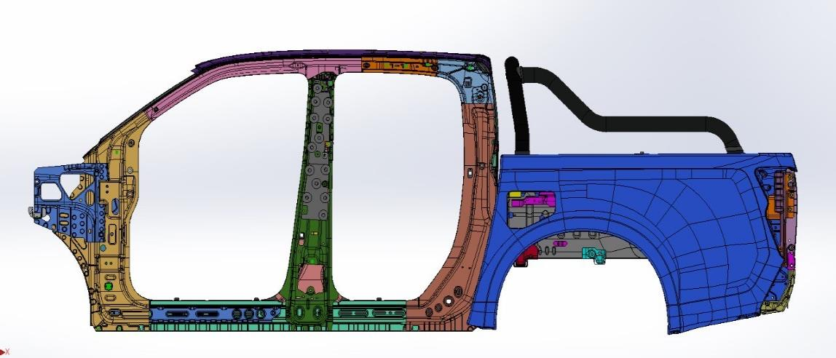
B: Isuzu Request
Without Side Plate – Concept
Designer : Grace Mata Futi
Date: 09 April 2025

Slide 5
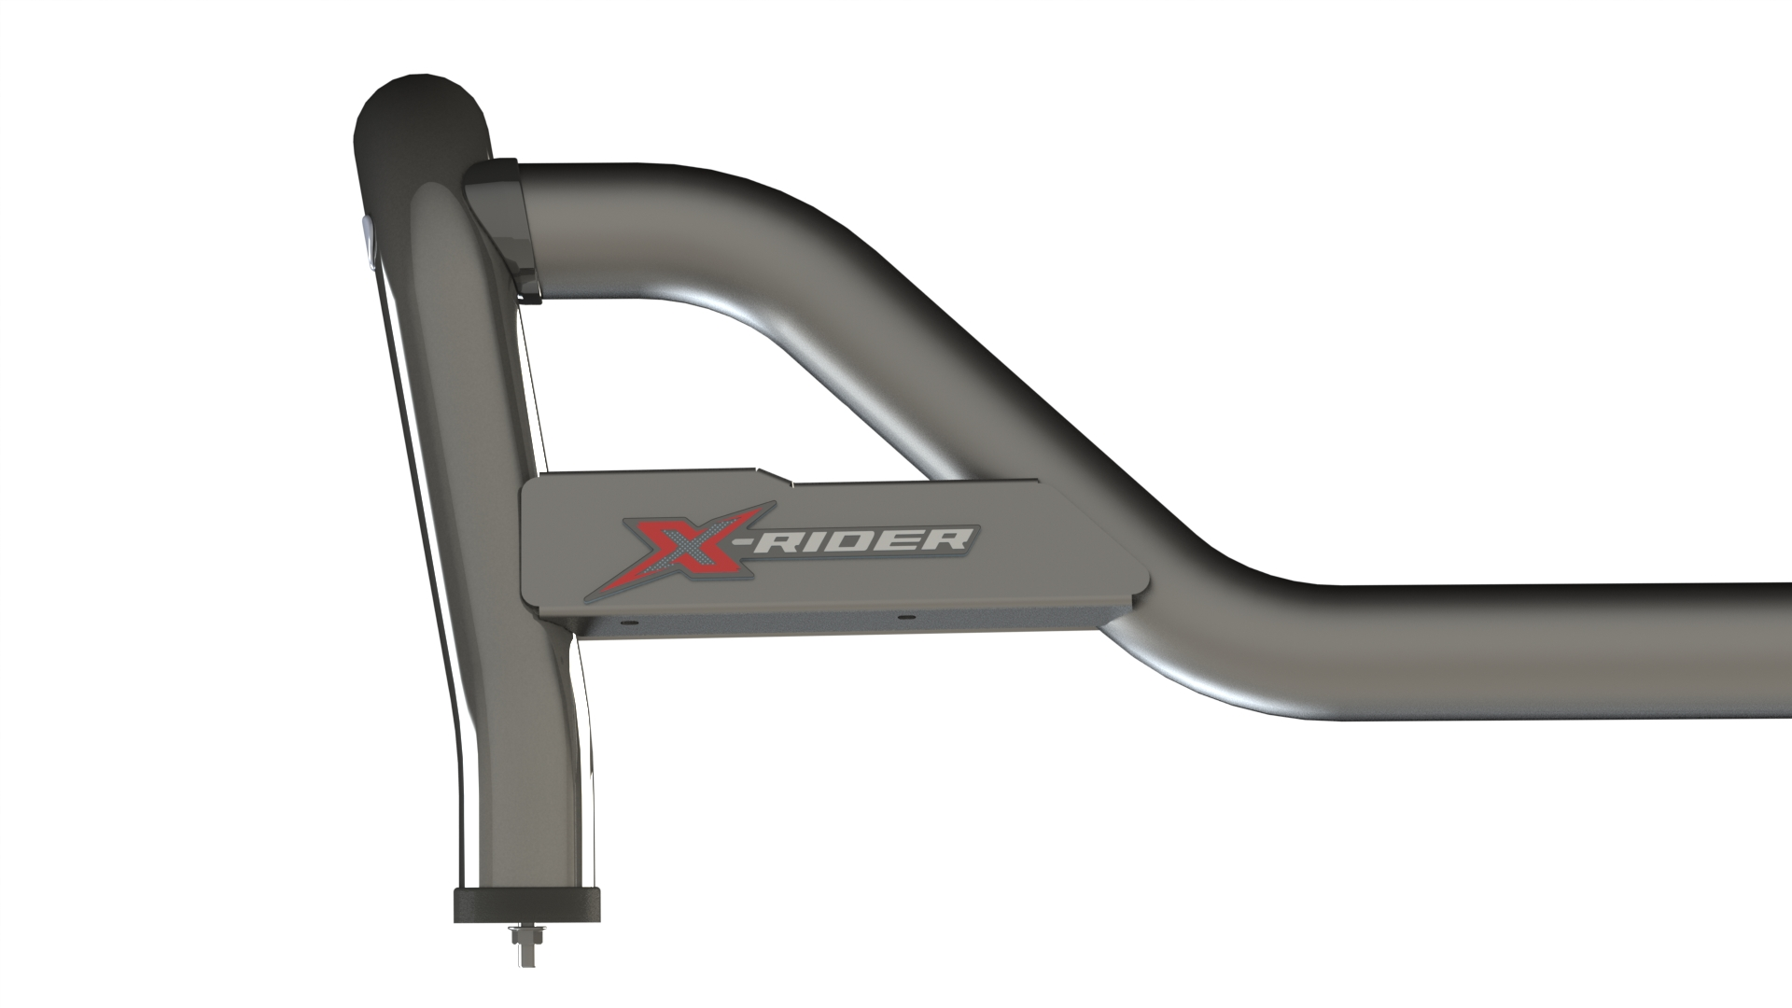
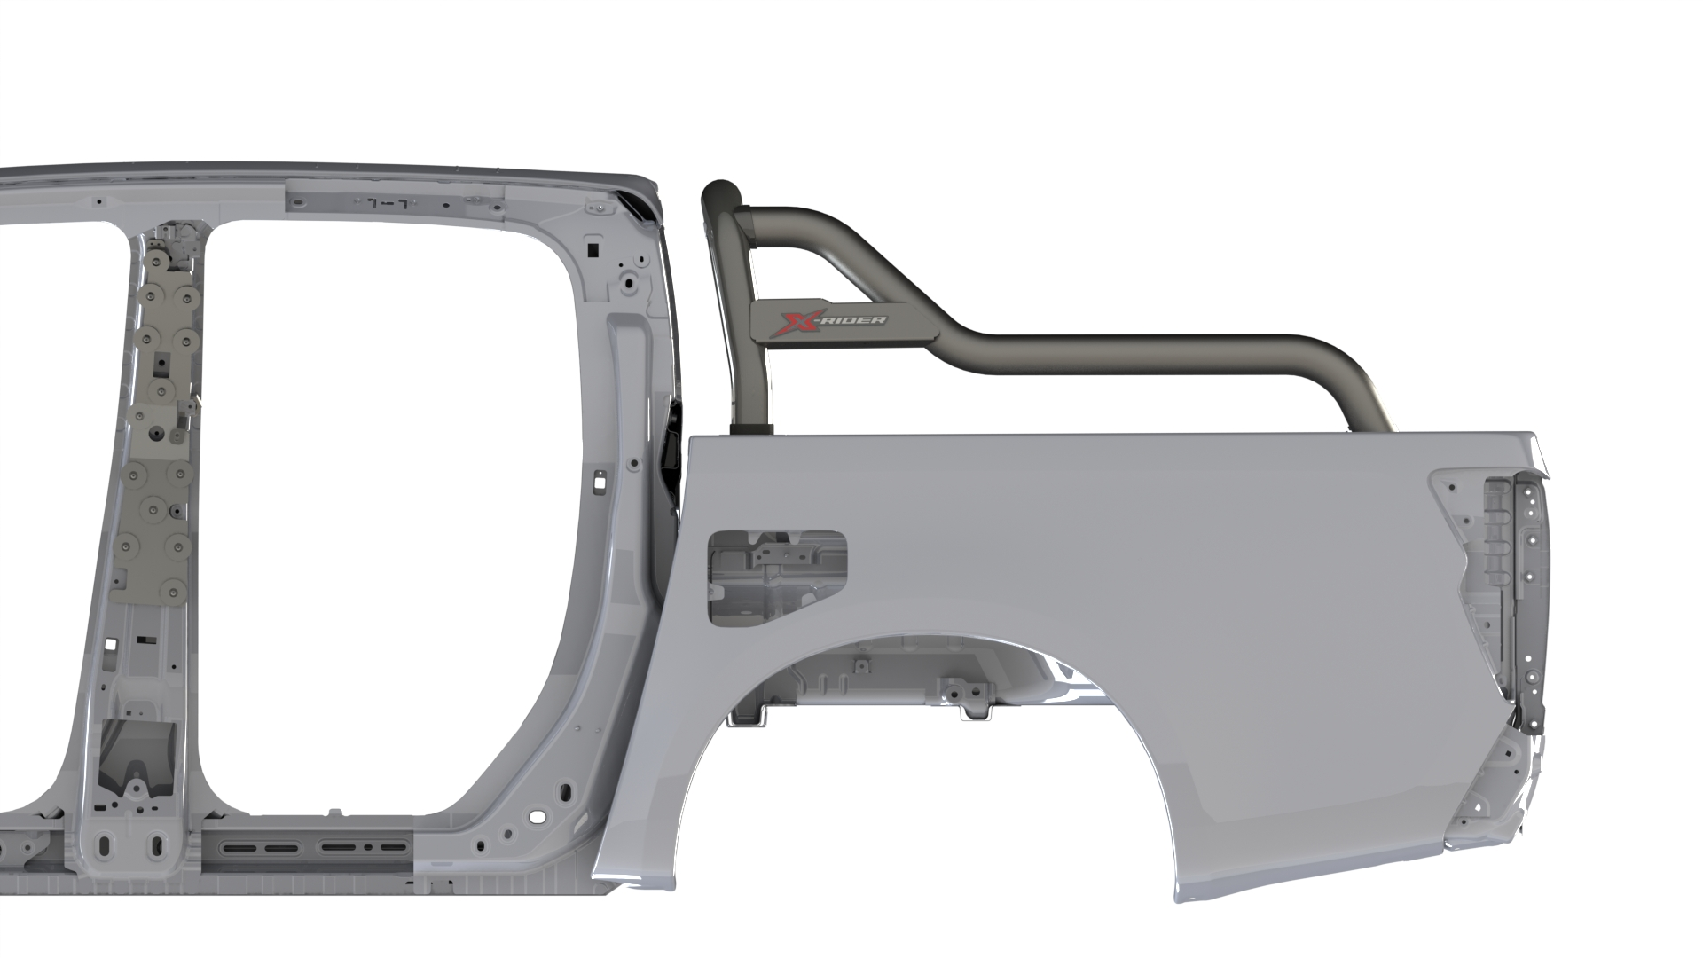
B: Isuzu Request
With X-Rider Side Plate – Concept
Note:
Front tube profile and front tube end cap rubber are the same as RG06.
Rear tube profile design changed; rear tube end cap rubber is the same as RG06.
Sill mount design changed, from front and rear mounting.
This concept has side plate and X rider sticker.
There is option for brake light. Stainless and Mild Steel.
Designer : Grace Mata Futi
Date: 09 April 2025

Slide 6

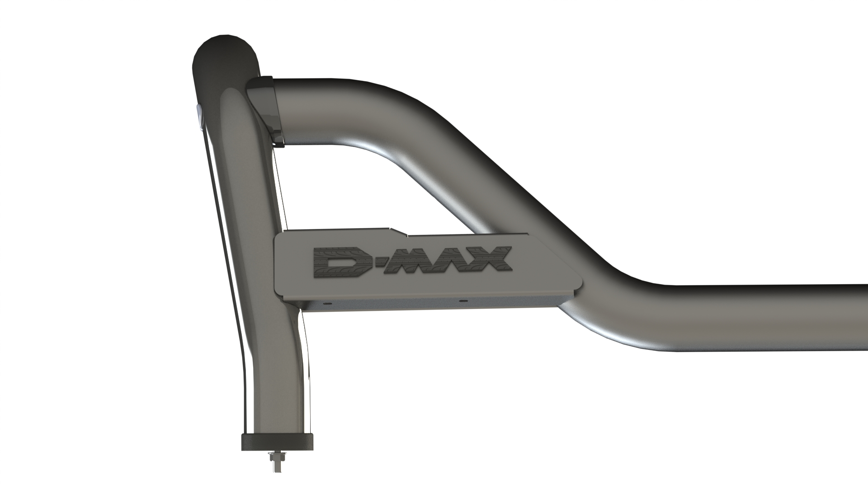
B: Isuzu Request
With D-Max Side Plate – Concept
Note:
Front tube profile and front tube end cap rubber are the same as RG06.
Rear tube profile design changed; rear tube end cap rubber is the same as RG06.
Sill mount design changed, from front and rear mounting.
This concept has side plate and D-Max sticker.
There is option for brake light. Stainless and Mild Steel.
Designer : Grace Mata Futi
Date: 09 April 2025

Slide 7
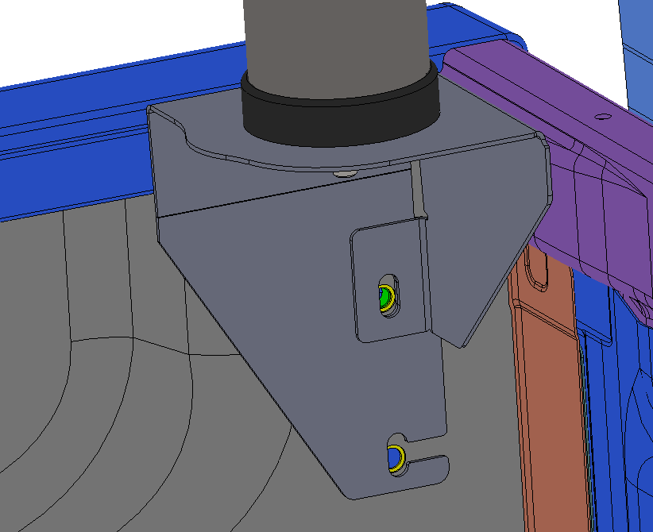
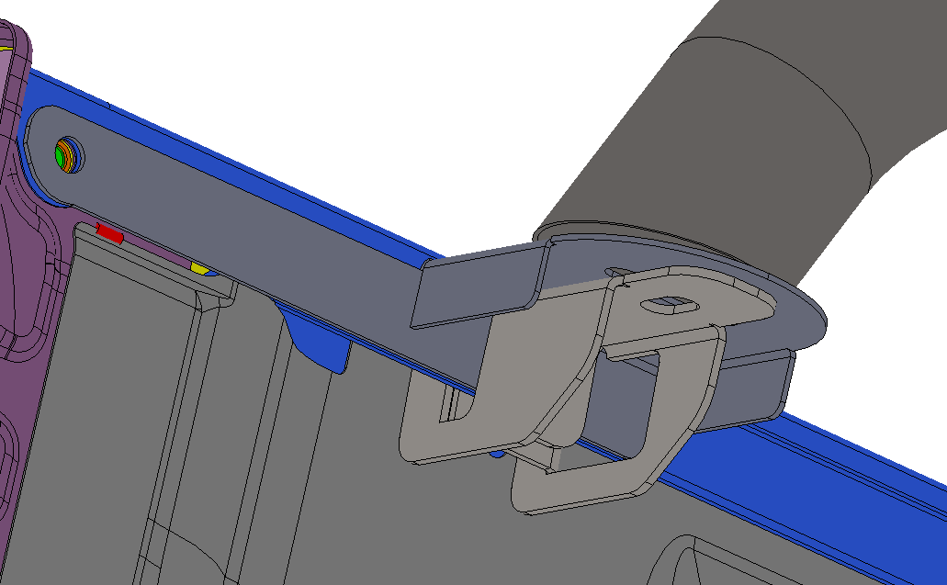
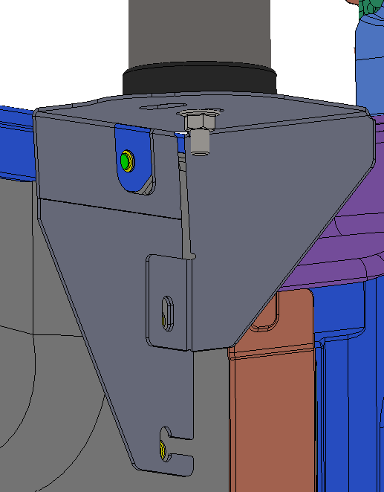
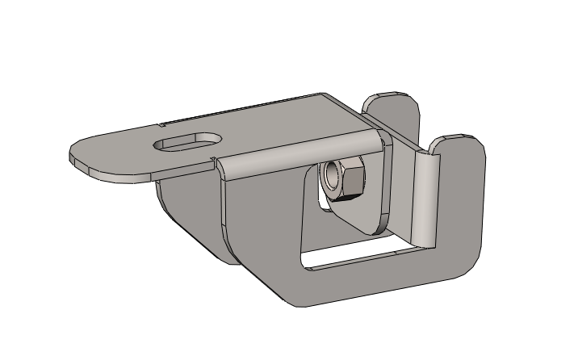
B: Isuzu Request
Front and Rear Sill Mount Concepts
Rear Left Sill Mount
Front Left Sill Mount
Mounting Hole
Mounting Clamp Bracket
Mounting Holes
Mounting Clamp Bracket
Designer : Grace Mata Futi
Date: 09 April 2025

Slide 8
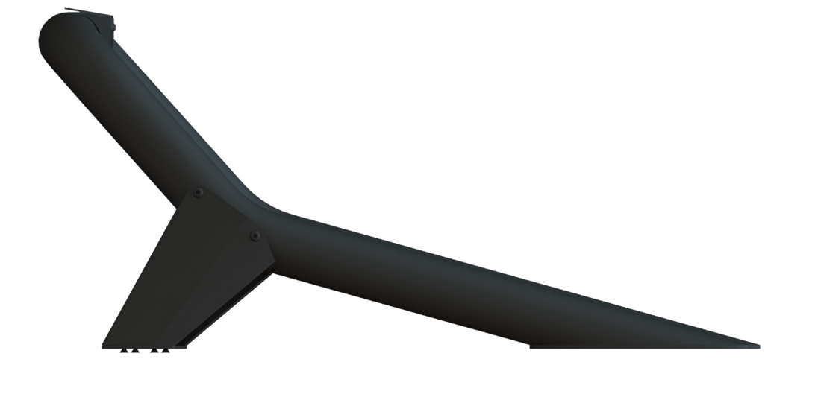
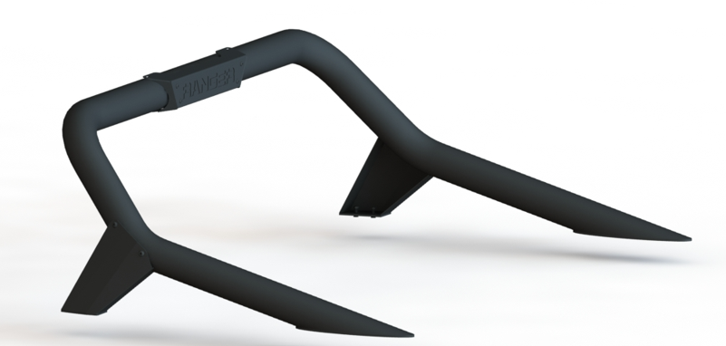
Styling Bar with Support Plate
ISUZU X-RIDER
AEROKLASDUYS
Mild Steel & Stainless-steel Tube
Support Plate 2mm
Diameter 76.2mm
SIDE-VIEW
ISO-VIEW
Designer : Grace Mata Futi
Date: 09 April 2025

Slide 9
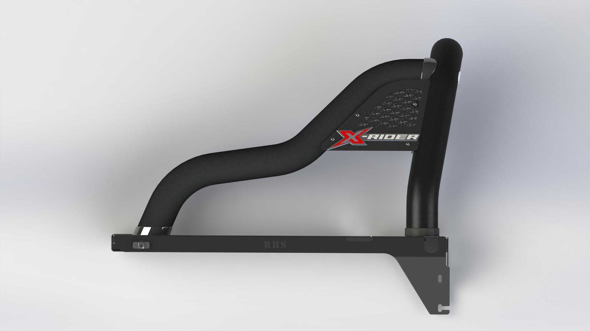
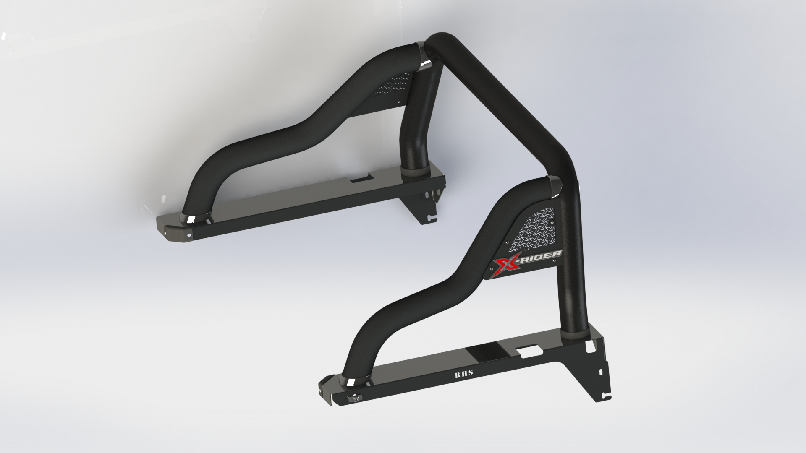
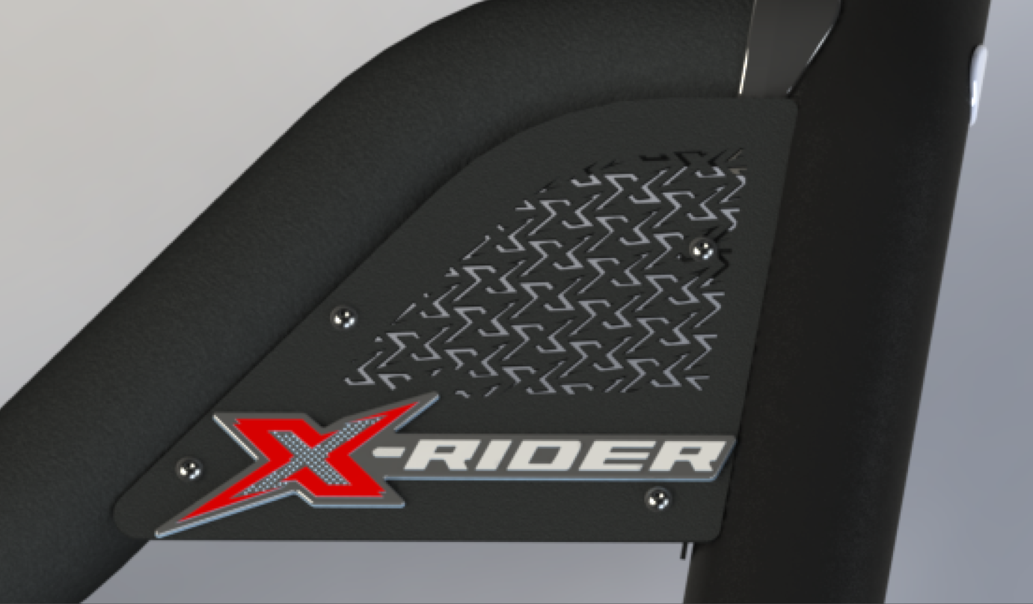
Styling Bar with Cross- Plate & Back Plate - Option 2
ISUZU X-RIDER
AEROKLASDUYS
SIDE-VIEW
ISO-VIEW
Detail-View
Mild Steel Coated black
Mild Steel Side Plate with small laser cut X
With Back Plate
X – Rider Decal
Designer : Grace Mata Futi
Date: 09 April 2025

Slide 10
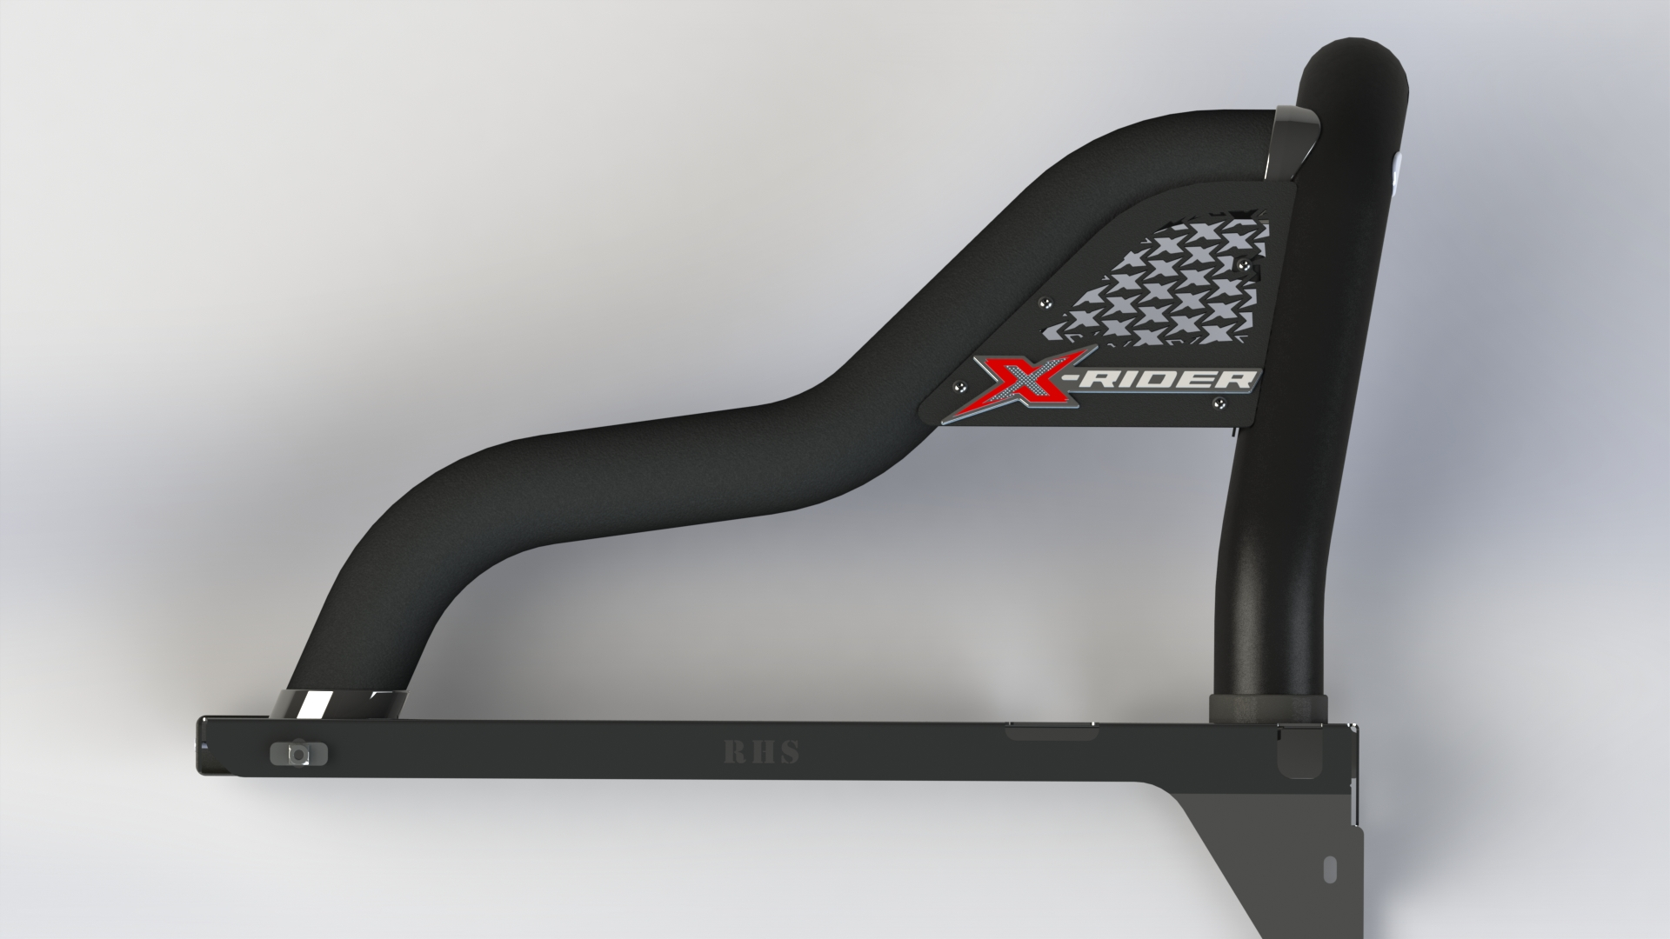
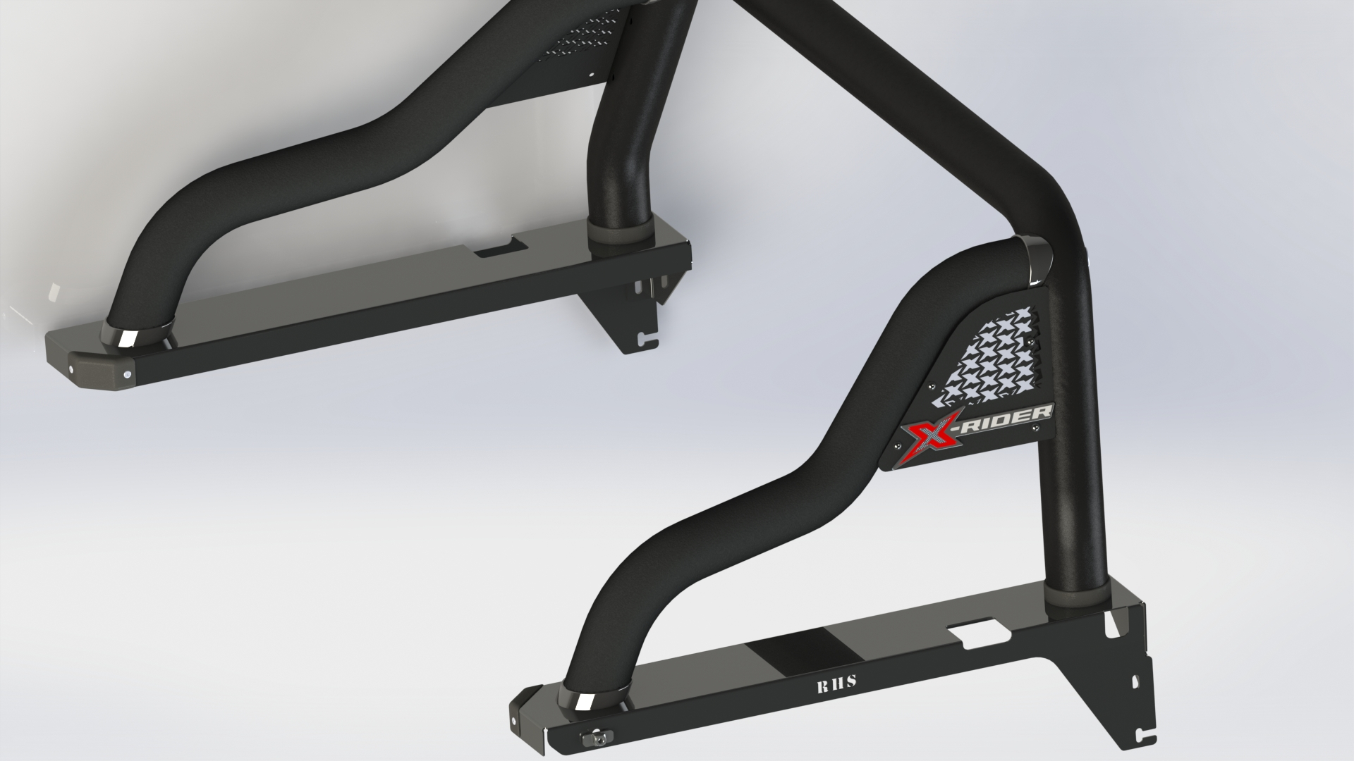
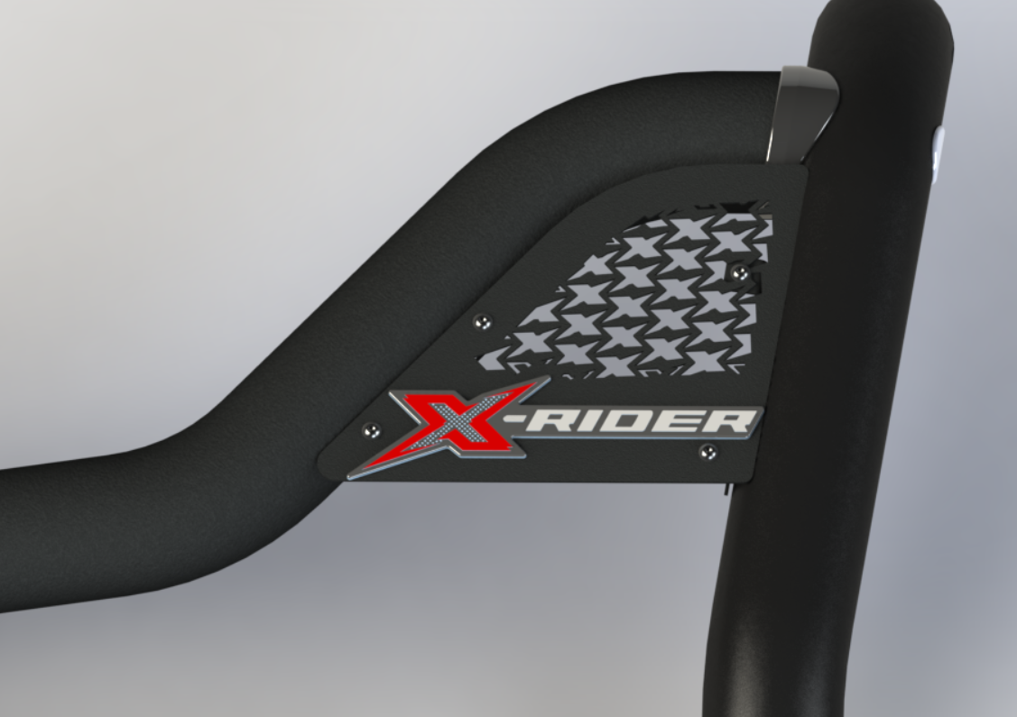
Styling Bar with Cross- Plate & No Back Plate - Option 3
ISUZU X-RIDER
AEROKLASDUYS
SIDE-VIEW
ISO-VIEW
Detail-View
Mild Steel Coated black
Mild Steel Side Plate with big laser cut X
With No Back Plate
X – Rider Decal
Designer : Grace Mata Futi
Date: 09 April 2025

Slide 11
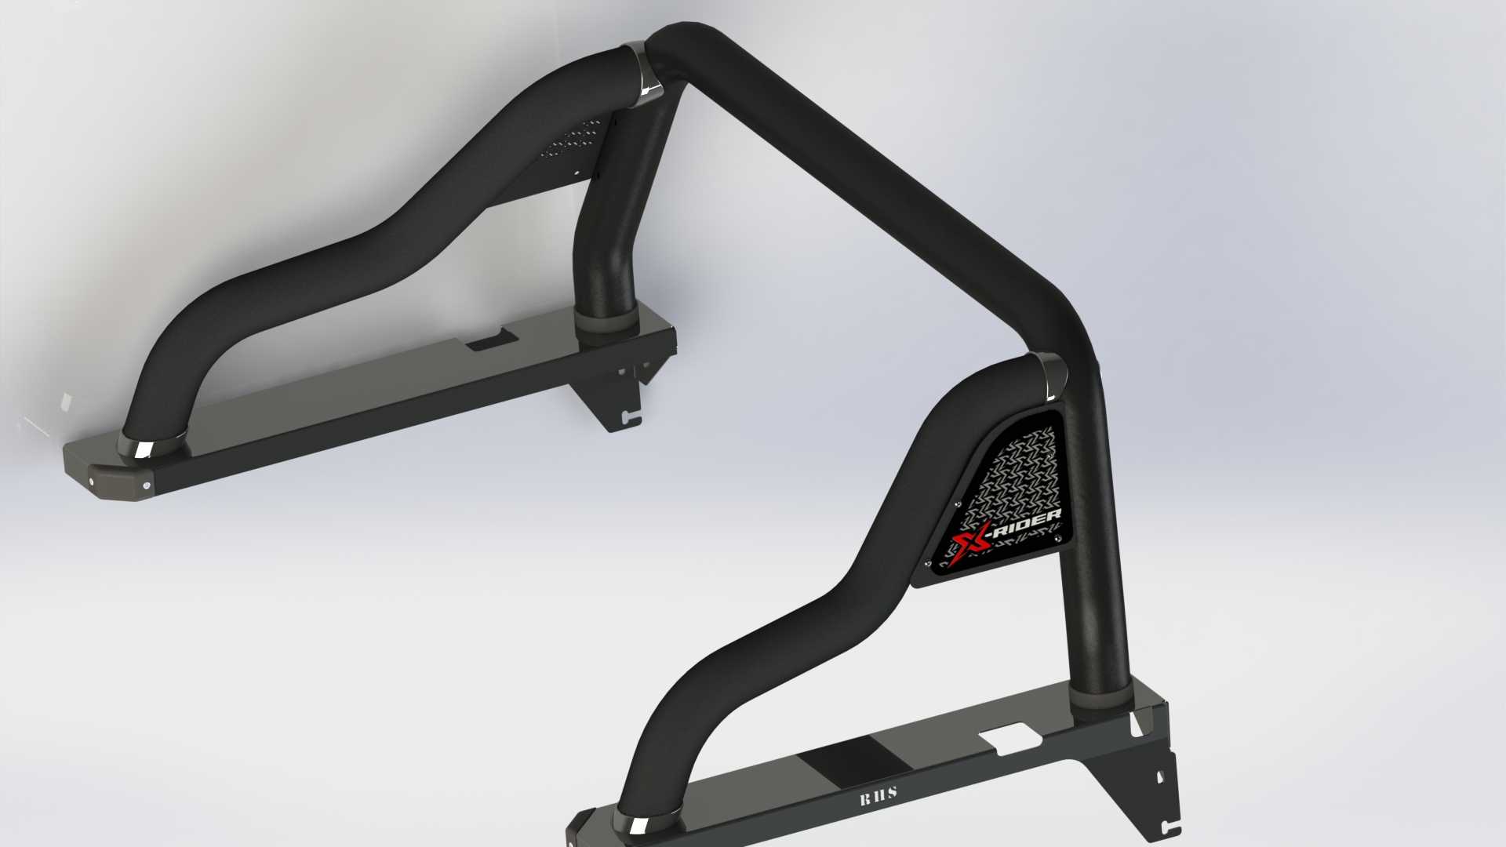
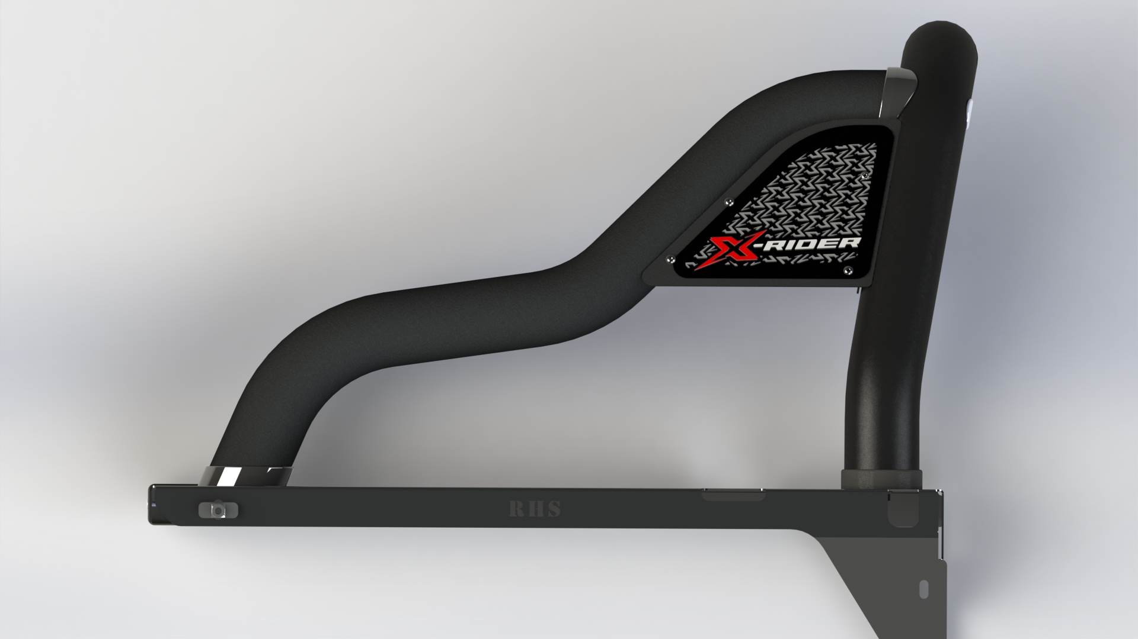
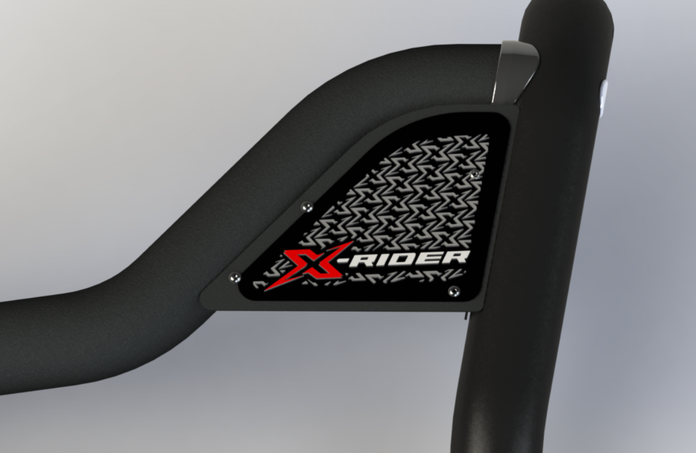
Styling Bar with Cross- Plate Blank – Option 5
ISUZU X-RIDER
AEROKLASDUYS
SIDE-VIEW
ISO-VIEW
Detail-View
Mild Steel Coated black
Mild Steel Side Plate no laser cut X
X – Rider Decal in Full size
Designer : Grace Mata Futi
Date: 09 April 2025

Slide 12
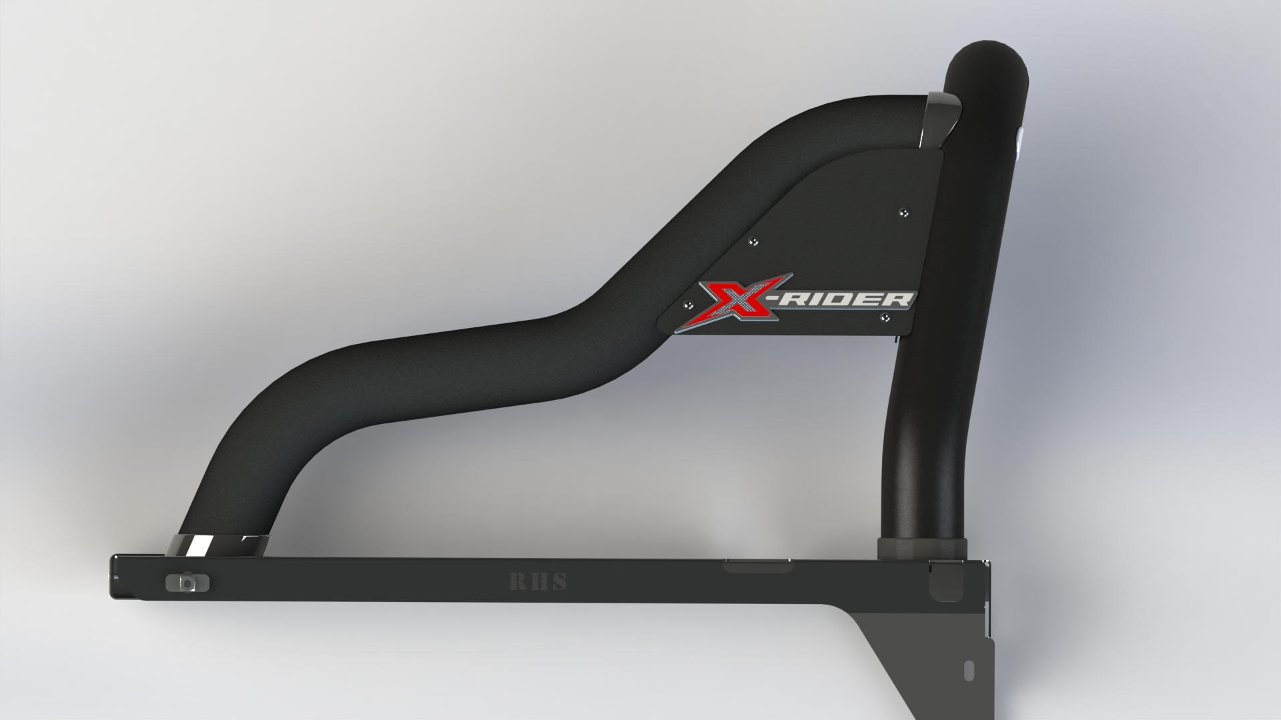
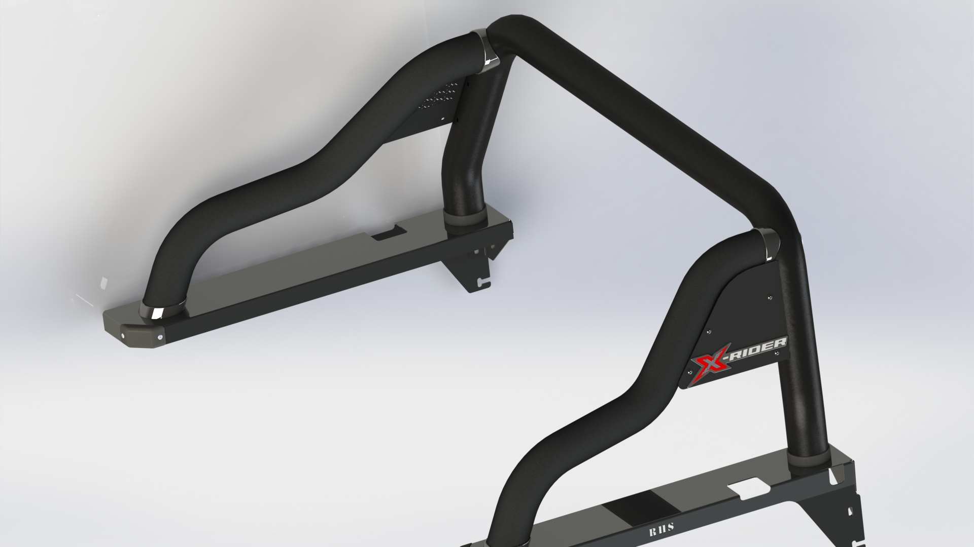
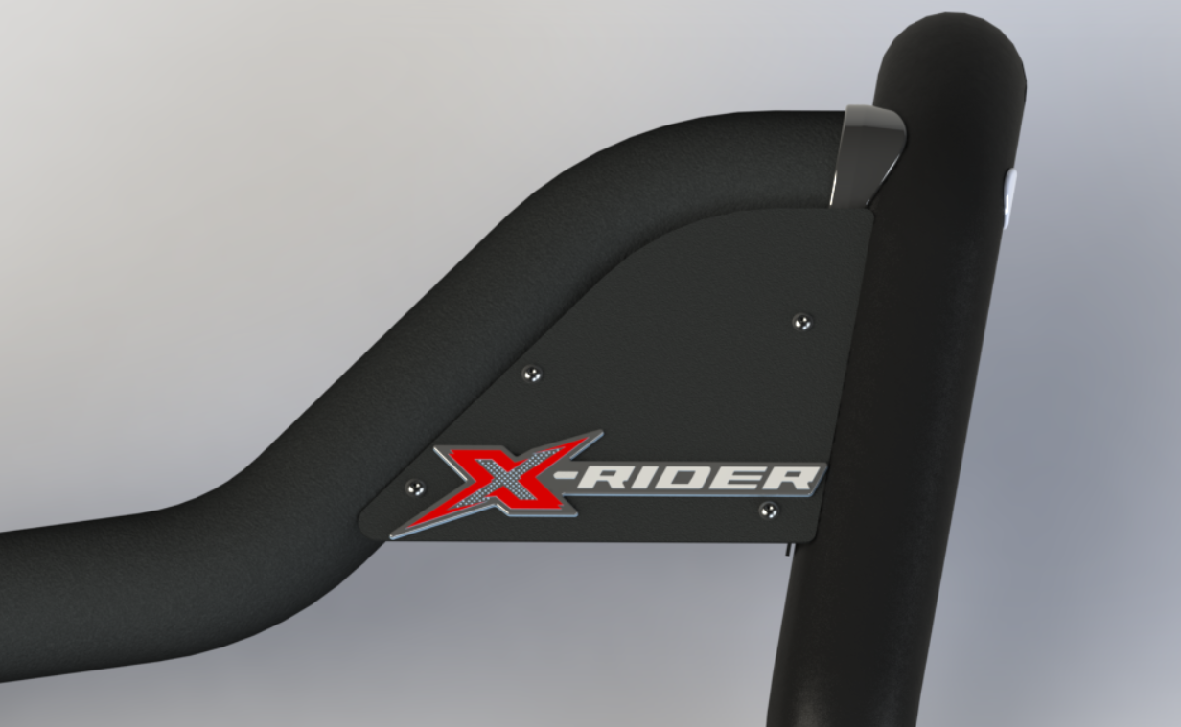
Styling Bar with Cross- Plate Blank – Option 6
ISUZU X-RIDER
AEROKLASDUYS
SIDE-VIEW
ISO-VIEW
Detail-View
Mild Steel Coated black
Mild Steel Side Plate no laser cut X
X – Rider Decal
Designer : Grace Mata Futi
Date: 09 April 2025

Slide 13
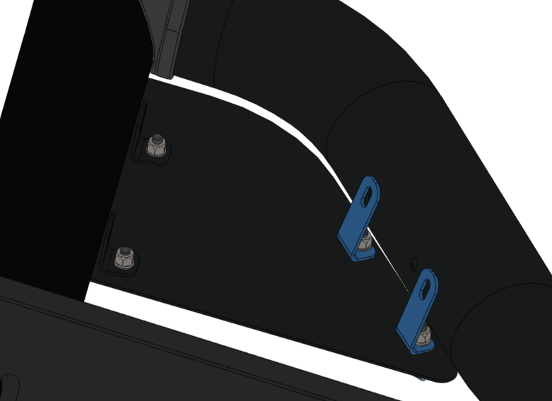
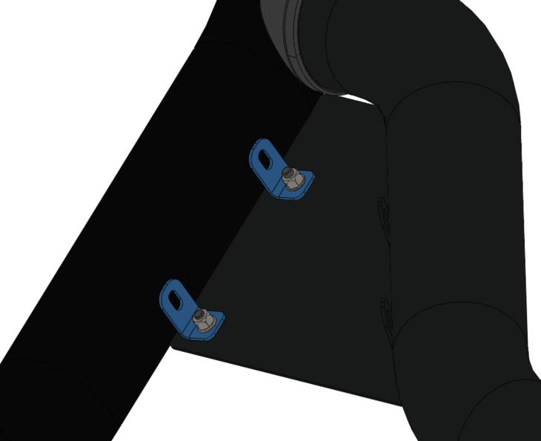
Side Plate Connection
ISUZU X-RIDER
AEROKLASDUYS
Individual Bracket attached the Front Pipe & Side Plate
Individual Bracket attached the Rear Pipe & Side Plate
Designer : Grace Mata Futi
Date: 09 April 2025

Slide 14
THE END
Designer : Grace Mata Futi
Date: 09 April 2025

